Slide 1


Group-2 Graduation Project May-2025
Group-2:

Slide 2
Table of contents
01
02
03
04
"Let me walk you through our journey. Here's what we'll cover today:"
Setting the Scene
Our Mission
Data Source
Data Cleaning
05
Data Modeling
06
Important Business Questions
07
Visualizing Insights with Dashboards
08
Strategic Recommendations

Slide 3
01
Setting the Scene:
Why Supply Chain Analysis?

Slide 4
Why Supply Chain Analysis?
"Every product you use goes through a supply chain. From raw materials to your doorstep, data is everywhere. But are we using that data wisely?“
In today’s complex supply chains, data is not just a resource it’s a roadmap. Our project focuses on extracting actionable insights from supply chain data to drive performance, reduce inefficiencies, and enhance supplier collaboration.

Slide 5
02
Our Mission
What We Set Out to Achieve?

Slide 6
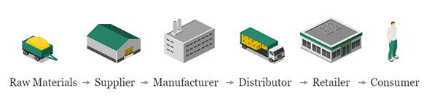
What We Set Out to Achieve?
"We didn’t just want to crunch numbers. We wanted to uncover patterns and solve real problems.“
Optimize inventory without overstocking
Reduce lead times, Costs, and delays
Identify inefficiencies
Enhance supplier performance tracking
Improve supplier performance
Target Customer Segments
Detect and correct data inconsistencies
Enable data-driven recommendations

Slide 7
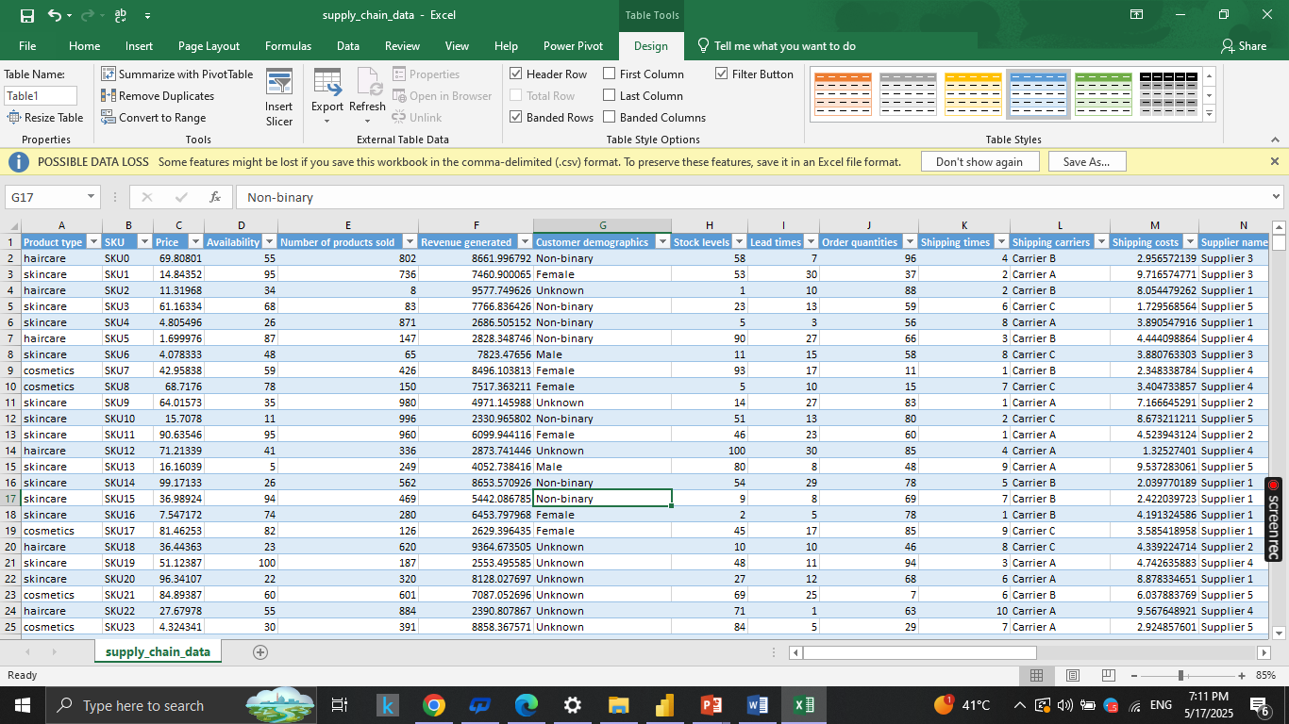
03
Data Source
Data Description:
The dataset includes 100 records and 27 columns related to:
Product Information: Product type, SKU, Price, Availability
Sales & Customer Data: Number of products sold, Revenue generated, Customer demographics
Inventory & Orders: Stock levels, Order quantities
Shipping & Logistics: Shipping times, Shipping carriers, Shipping costs, Transportation modes, Routes, Costs
Supplier & Manufacturing: Supplier name, Location, Lead time, Production volumes, Manufacturing costs, Manufacturing lead time
Quality Control: Inspection results, Defect rates
https://drive.google.com/file/d/1fpxB64Z4iuKAbXD4Jf2Dc0TQnw8ulZmR/view?usp=drive_link

Slide 8
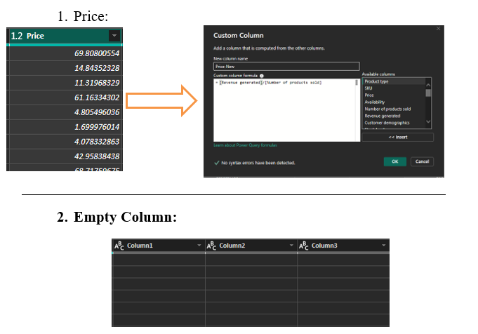
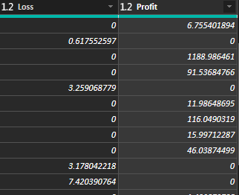
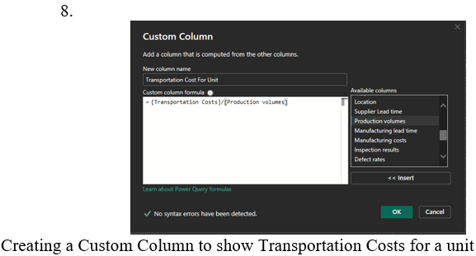
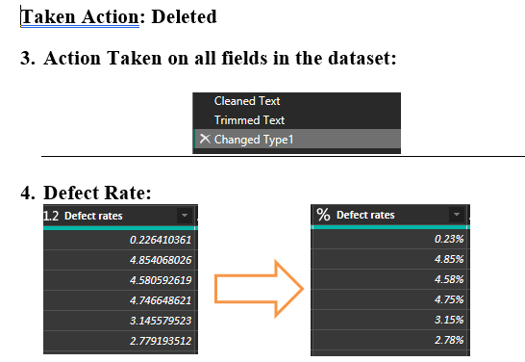
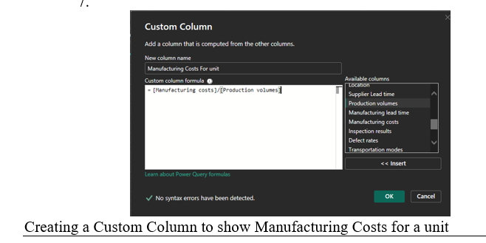
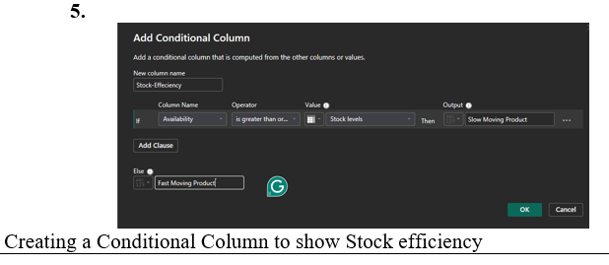
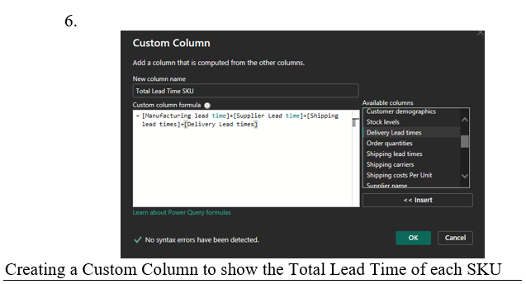
Data Cleaning and Preparation
04

Slide 9
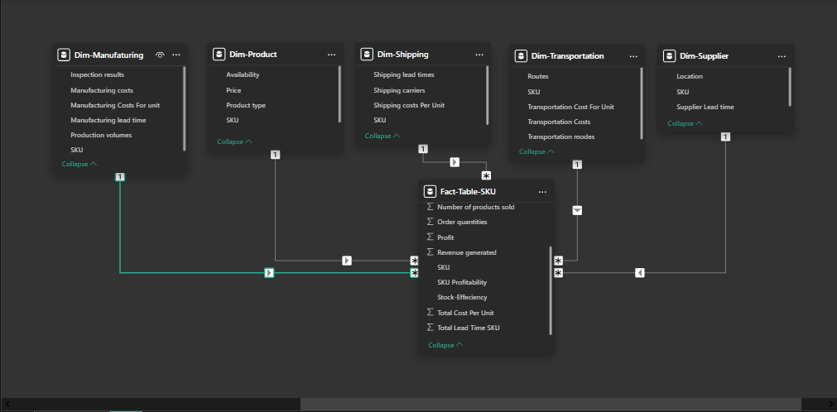
03
Data Modeling
This data model represents a supply chain schema with interconnected dimensions and a fact table:
Dim-Manufacturing: Tracks inspection results, manufacturing costs, lead time, production volumes, and SKU.
Dim-Product: Contains product availability, price, product type, and SKU.
Dim-Shipping: Includes shipping carriers, shipping costs per unit, and SKU.
Dim-Transportation: Covers transportation cost per unit, transportation modes, and SKU.
Dim-Supplier: Details supplier location, lead time, and SKU.
Fact-SKU: Central fact table linking all dimensions, capturing:
Number of products sold
Order quantities
Profit
Revenue generated
SKU profitability
Stock efficiency per unit
Average lead time per SKU

Slide 10
06
Important Business Questions

Slide 11
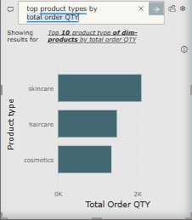
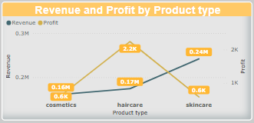
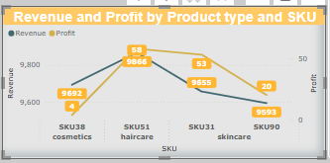

Sales & Product Performance
Which product types generate the highest revenue?
Which SKUs have the highest number of units sold?
What is the relationship between product price and sales volume?

Slide 12
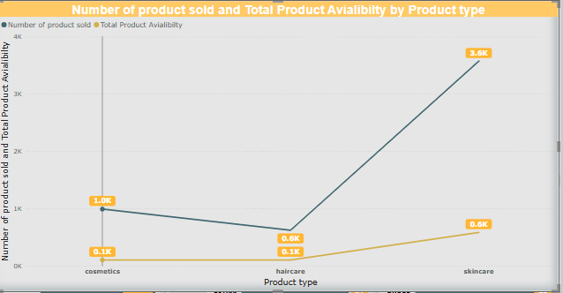
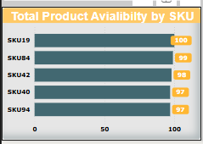
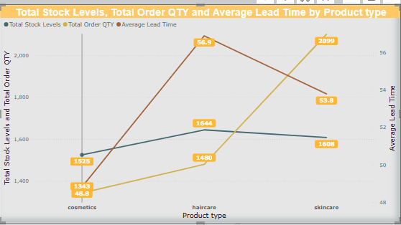
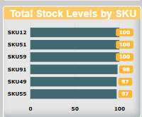
Inventory & Availability
Which products have low stock levels or high stockout risk?
Is there a correlation between availability and sales performance?
How do lead times influence stock levels and ordering behavior?

Slide 13
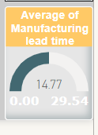
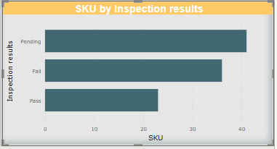
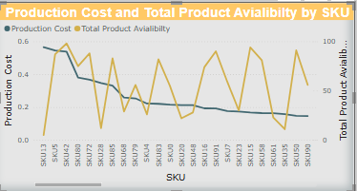
Supplier & Manufacturing Analysis
Which SKUs are linked to high defect rates or failed inspections?
How do manufacturing costs vary by product type or supplier?
What are the average manufacturing lead times by supplier?

Slide 14
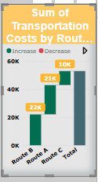
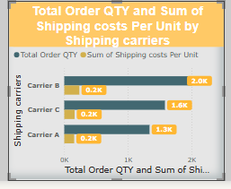
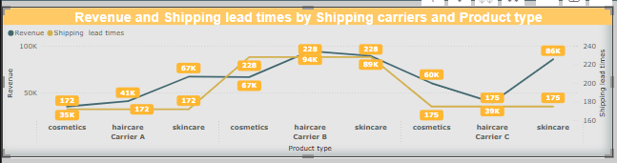
Shipping & Logistics
Which shipping carriers are most cost-effective?
What is the average shipping time by Product Type?
Are specific routes causing higher costs?

Slide 15
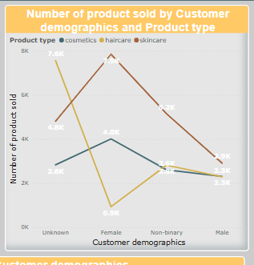
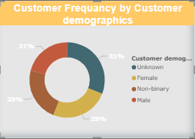
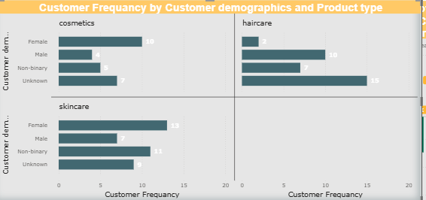
Customer Demographics
How do customer demographics influence purchasing patterns?
Are certain products preferred by specific customer segments?

Slide 16
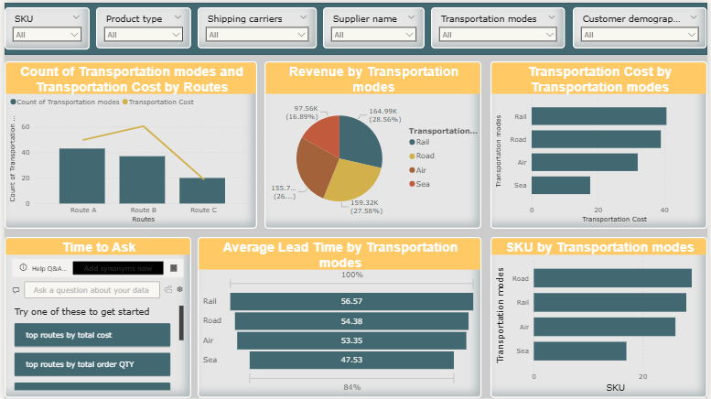
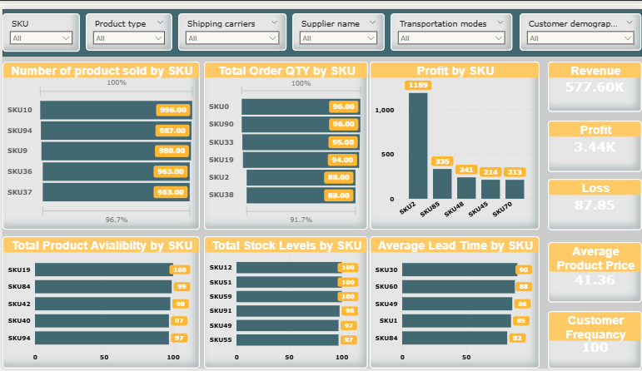
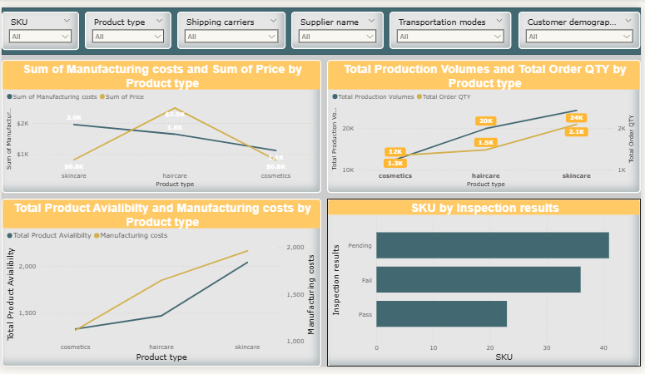
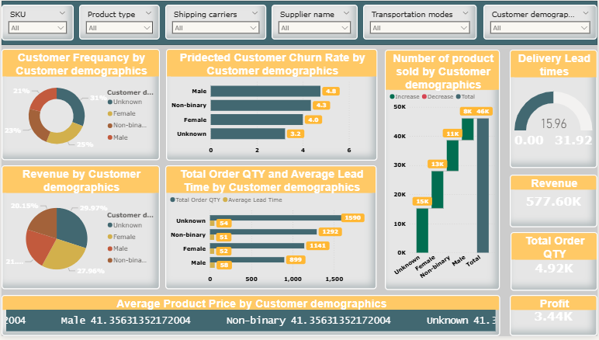
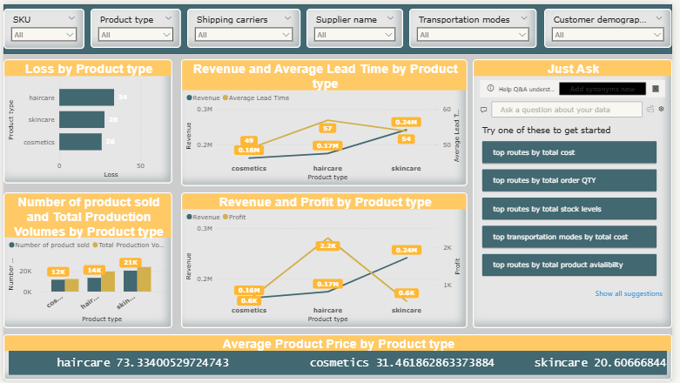
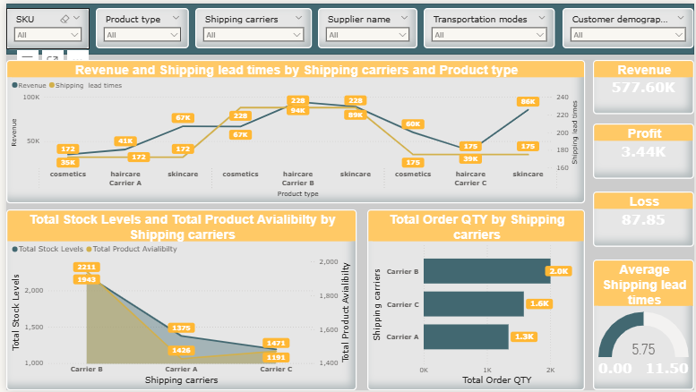
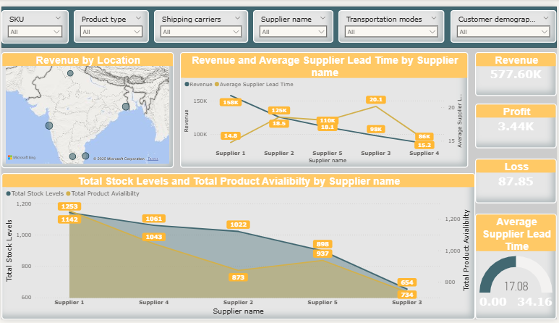
05
Visualizing Insights with Dashboards

Slide 17
SKU Analysis:

Slide 18

Insights From SKU Analysis:
Profit Issue: Revenue 577.60K, but profit only 3.44K with 87.85 loss; SKU0 high revenue (1,119), others lag (e.g., SKU22: 335).
Stock Gaps: SKU12, SKU51 at 100% stock/availability; SKU0, SKU4 lower availability (87%, 97%) despite high stock.
Lead Time Delays: SKU30 (90 days), SKU0 (82 days) have longest lead times; SKU49, SKU84 better (85, 82 days).

Slide 19
Recommendations(SKU):
Boost Profit: Adjust pricing/costs to cut 87.85 loss.
Optimize Stock: Reallocate for SKU0, SKU4 to match high demand, avoid stockouts.
Cut Lead Times: Work with suppliers to reduce SKU30, and SKU0 lead times (90, 82 days).
Improve Forecasting: Use sales data for SKU10, SKU4, SKU0 to align stock with demand.

Slide 20
Customer Analysis:

Slide 21

Insights From Customer Analysis:
Customer Demographics: Unknown (31%), Female (35%), Non-binary (27.9%) lead frequency; Male (4.8%) highest churn risk.
Sales by Demographics: Unknown (46K), Female (15K) top sales; Male (8K) lowest despite high churn risk.
Order & Lead Time: Unknown (1,950 orders, 54 days lead), Female (1,421 orders, 51 days) dominate; Male (899 orders, 58 days) lags.
Delivery Performance: average lead time 31.92 days.
Financials: Revenue 577.60K, profit 3.44K, order qty 4.9K; profitability remains low.

Slide 22
Recommendations(Customer):
Target Churn: Focus retention on Male customers (4.8 churn) with promotions.
Boost Sales: Market to Unknown/Female groups (46K, 15K sales) for growth.
Reduce Lead Times: Address delays (31.92 days) by optimizing logistics.
Improve Profit: Analyze costs for Unknown/Female orders (1,950, 1,421) to increase 3.44K profit.
Enhance Forecasting: Use Unknown/Female order data (1,950, 1,421) for better demand planning.

Slide 23
Product Analysis:

Slide 24

Insights From Product Analysis:
Loss Distribution: Haircare (28), cosmetics (18), skincare (14) show varying losses, with haircare highest.
Sales Volume: Haircare (21K), cosmetics (14K), skincare (13K) lead in product sold.
Revenue & Profit: Haircare (0.57M rev, 0.24K profit), cosmetics (0.49M rev, 0.16K profit), skincare (0.34M rev, 0.02K profit) show skincare underperforming.
Lead Times: Haircare (57 days), cosmetics (49 days), skincare (34 days) indicate efficiency gaps.
Pricing: Haircare (73.34), cosmetics (31.46), skincare (20.60) suggest pricing impacts profitability.

Slide 25
Recommendations(Product):
Reduce Losses: Target haircare (28 loss) for cost optimization.
Boost Skincare: Increase marketing for skincare (13K sales, 0.02K profit) to match haircare/cosmetics.
Improve Lead Times: Reduce skincare (34 days) and haircare (57 days) lead times via logistics.
Adjust Pricing: Raise skincare price (20.60) to improve 0.02K profit margin.
Optimize Inventory: Focus stock on haircare (21K sales) to maximize 0.24M profit.

Slide 26
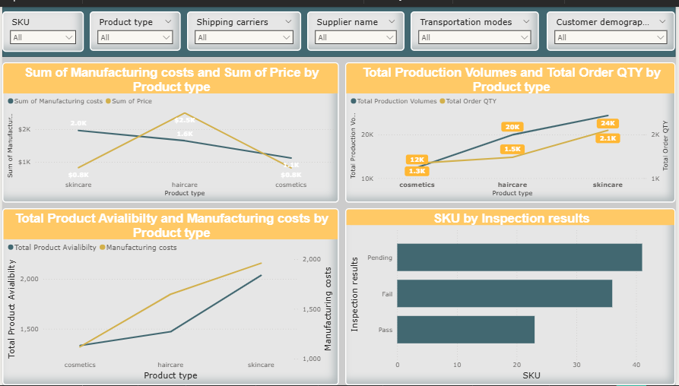
Production Analysis:

Slide 27

Insights and recommendations (Production) Analysis:
Insights:
Skincare: High manufacturing costs ($1.5K) vs. low price ($0.5K); Haircare: Low costs ($0.5K), high price ($1.5K).
Haircare has more production (1.8K) and orders (2.4K) than skincare (1.3K, 1.5K).
Haircare availability (1.5K) with lower costs ($500); Skincare availability (1K) with higher costs ($1.5K).
Many SKUs pending inspection (40), fewer fail (20) or pass (10).
Recommendations:
Raise skincare prices or cut costs.
Increase haircare production to meet demand.
Speed up inspection process to clear Checkup.

Slide 28
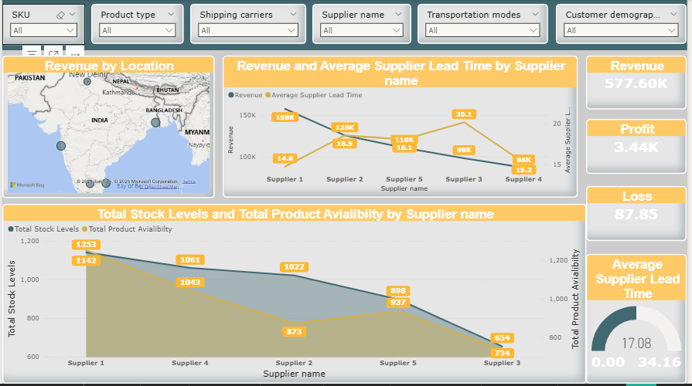
Supplier Analysis:

Slide 29
Insights and recommendations (Supplier) Analysis:
Insights:
Recommendations:
.
Revenue by location shows varied performance, with some areas generating up to 158K.
Supplier 1 has the highest stock levels (1233) and availability (1142), while Supplier 3 has the lowest (674, 734).
Supplier 1 has the shortest lead time (14.8 days), while Supplier 3 has the longest (20.1 days).
Profit is 3.44K, but a significant loss of 87.85 is noted.
Focus on high-revenue locations to boost overall sales.
Address Supplier 3’s low stock and long lead times to improve supply chain efficiency.
Investigate the cause of the loss and implement cost-saving measures.
Leverage Supplier 1’s strong performance for broader supply needs.

Slide 30
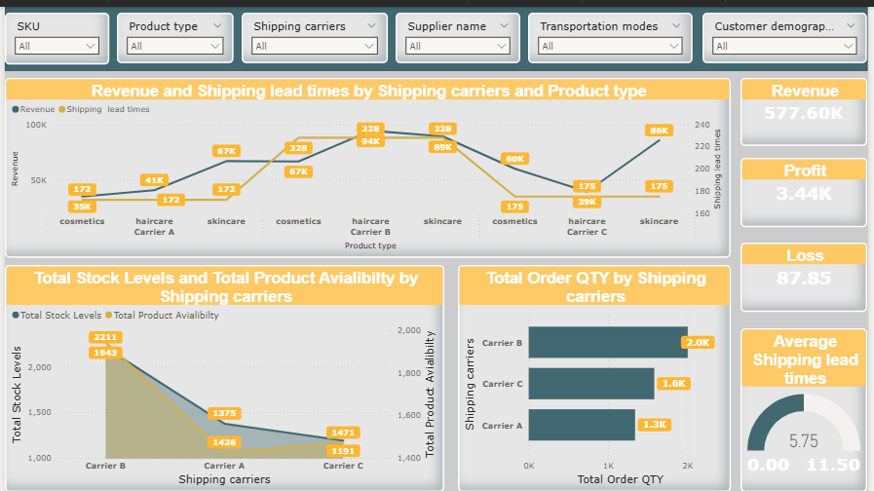
Shipping Analysis:

Slide 31

Insights and recommendations (Shipping) Analysis:
Insights:
Revenue varies by carrier and product: Carrier B’s most influencer
Shipping lead times are longest for Carrier C’s skincare (228 days) and shortest for Carrier A’s cosmetics (172 days).
Stock levels are highest with Carrier B (2111),
Order quantities are highest with Carrier B (2K), followed by Carrier A (1.6K) and Carrier C (1.3K).
Recommendations:
Optimize Carrier C’s operations to reduce long lead times, especially for skincare.
Increase stock levels for Carrier A to match its high availability and demand.
Focus on Carrier B for higher order fulfillment due to its strong order quantity performance.
Investigate the loss to improve overall profitability.

Slide 32
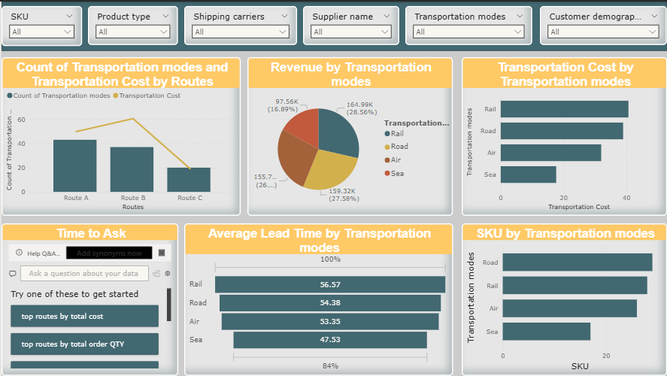
Transportation Analysis:

Slide 33

Insights and recommendations (Transportation) Analysis:
Insights:
Transportation Modes by Routes: Route A has the most modes (around 50) and highest cost (around 40), while Route C has the fewest (around 20) and lowest cost (around 15).
Revenue by Modes: Rail leads with 97.58K (59%), followed by Sea (27.89K, 17%), Air (26%), and Road (16.54K, 10%).
Transportation Cost by Modes: Rail has the highest cost (around 40), Sea the lowest (around 15).
Average Lead Time: Rail has the longest lead time (56.57 days), Sea the shortest (47.53 days).
SKUs by Modes: Rail handles the most SKUs (around 30), Sea the fewest (around 10).
Recommendations:
Optimize Rail Efficiency: Reduce rail costs and lead times despite high revenue and SKU volume.
Increase Sea Usage: Leverage sea transport for lower costs and faster lead times.
Review Route A Costs: Investigate and reduce Route A’s high transportation costs.
Balance SKU Distribution: Spread SKUs across modes to lessen reliance on rail and avoid delays.

Slide 34

01
02
03
04
Nada Kamal
Roaa Hatem
Mohamed Kamal
Yusuf Muhammad
Michael Hany
05
06
Abdullah Osama

